Slide 1





Department of Computer Science & Engineering (AIML)
Project Work
21AIP76
Brain Tumor Classification
Using a Highly Precise Attention
Based Convolutional Neural Network
Submitted by:
Bhuvana.S – 4AD21CI013
Darren Stallone Mendez - 4AD21CI017
Chethan T - 4AD21CI016
Harshith S - 4AD21CI022
Under the Guidance of :
Dr. Anil Kumar C J
Assoc. Professor & HOD Department of CSE (ARTIFICIAL INTELLIGENCE &MACHINE LEARNING)
Department of Computer Science and Engineering - AIML

Slide 2
CONTENTS
It covers essential aspects such as
Introduction
Literature survey
Existing Systems
Problem Statement
Proposed System
Objectives
Methodology
System Requirements and Specification
Results
Conclusion
Future Scope
References
Department of Computer Science and Engineering - AIML

Slide 3
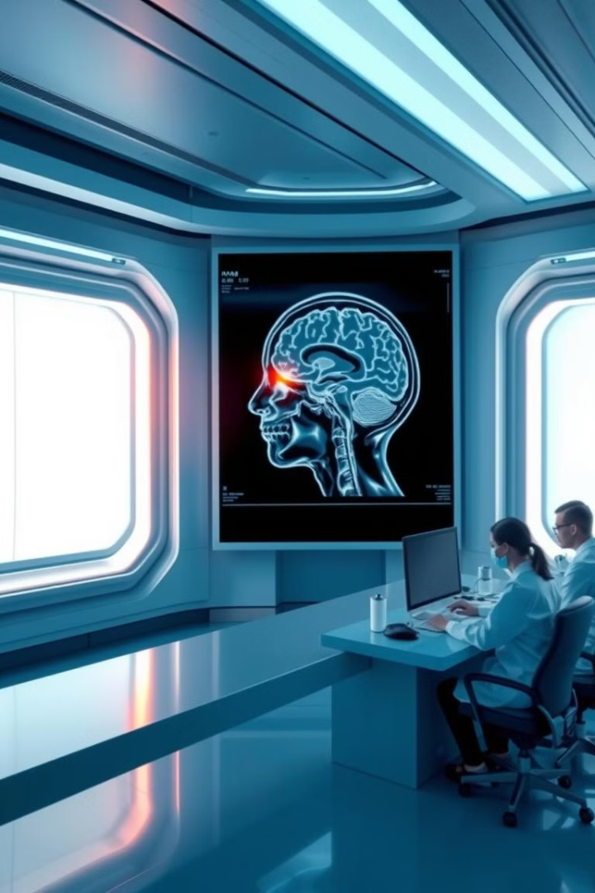
Introduction:
Brain tumor detection is a critical medical process aimed at identifying abnormal growths in brain tissue. It typically involves imaging techniques such as MRI and CT scans to analyze the brain's structure. Recent advancements incorporate artificial intelligence and machine learning, enhancing accuracy and efficiency in detecting tumors at early stages, improving treatment outcomes.
Department of Computer Science and Engineering - AIML

Slide 4
Literature Survey
[1] Brain Tumor Classification Using Convolutional Neural Networks
• Author: Sachin S. Patil, V. Kumar
• Date of Conference: 2021 • Date Added to IEEE Xplore: 20 October 2021 This paper presents a CNN-based approach for brain tumor classification using MRI images. The authors discuss the use of deep learning techniques to automatically extract features and classify tumors into different types. The network was trained on a dataset of brain MRI scans and achieved significant accuracy compared to traditional machine learning techniques. Challenges related to model overfitting and dataset imbalance were addressed using data augmentation and dropout.
[2] Deep CNN with Connected CRF for Brain Tumor Segmentation
• Author: A. Kamnitsas, C. Ledig, V.F.J. Newcombe
• Date of Conference: MICCAI 2022 • Date Added to IEEE Xplore: 10 October 2022 The authors proposed a deep CNN architecture combined with Conditional Random Fields (CRF) for brain tumor segmentation and classification. Their approach incorporates 3D CNNs with dense connections and multi-scale analysis to better capture the complex structures of brain tumors. Attention mechanisms were explored to focus the model on important regions within the tumor, resulting in improved classification accuracy.
Department of Computer Science and Engineering - AIML

Slide 5
Literature Survey
[3] Attention U-Net: Learning Where to Look for the Pancreas
• Author: Ozan Oktay, Jo Schlemper, Loic Le Folgoc
• Date of Conference: MICCAI 2022• Date Added to IEEE Xplore: 10 December 2022 Although this paper focuses on pancreas segmentation, it introduced an attention mechanism that can be adapted for brain tumor classification. The Attention U-Net was designed to focus on the relevant areas in medical images, providing a foundation for CNNs that classify brain tumors. The model uses spatial attention gates to suppress irrelevant regions and emphasize important features, yielding higher precision in tumor detection tasks.
[4] Brain Tumor Segmentation and Classification Using CNN
• Author: P. Afshar, M. Plataniotis, A. Mohammadi
• Date of Conference: 2021 • Date Added to IEEE Xplore: 5 June 2021 This paper proposed a novel 3D CNN architecture for both segmentation and classification of brain tumors from MRI images. The model used attention modules to prioritize tumor regions during training. The authors emphasized the effectiveness of attention-based models in distinguishing between healthy and tumorous tissues, with high classification accuracy. The study also highlighted the need for more diverse datasets to improve model generalization.
Department of Computer Science and Engineering - AIML

Slide 6
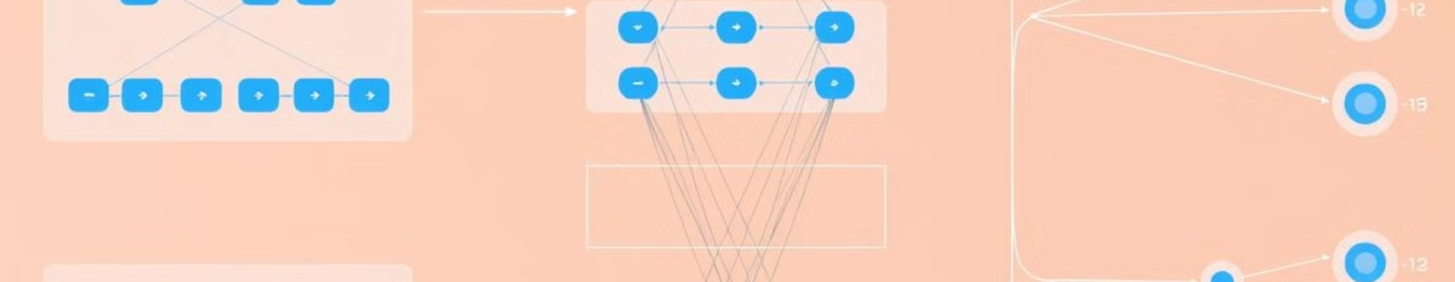
Existing Systems :
Traditional Machine Learning
algorithms
Multi-path Deep Learning
Multi-modal Frameworks
Hybrid Models
Traditional machine learning algorithms in brain tumor classification use extracted features for diagnosis, employing SVM, KNN, RF, or ensemble methods.
Utilizing multiple pathways in a network, allowing for the extraction of diverse features for improved accuracy.
Integrating data from multiple sources, such as MRI scans and patient information, for more comprehensive analysis.
Combining CNNs with traditional machine learning algorithms for enhanced classification performance.
Department of Computer Science and Engineering - AIML

Slide 7
Problem Statement
The problem is to accurately classify brain tumors using medical imaging, which is critical for effective diagnosis and treatment. The challenge lies in developing a precise, automated method that can handle the variability and complexity of tumor features.
Department of Computer Science and Engineering - AIML

Slide 8
Proposed System
The proposed system for brain tumor classification utilizes Convolutional Neural Networks (CNNs) enhanced with attention mechanisms for improved accuracy in medical imaging. The architecture includes multiple layers for feature extraction, attention modules to focus on relevant regions of MRI scans, and classifiers for accurate diagnosis. This design facilitates the efficient processing of visual data, enabling the system to detect tumors in real time and provide critical insights for timely medical intervention.
Department of Computer Science and Engineering - AIML

Slide 9



Objectives:
Model Development
1
To design a precise attention-based convolutional neural network (CNN) for brain tumor classification from MRI scans.
Improve Accuracy
2
To enhance diagnostic accuracy by incorporating attention mechanisms that focus on relevant image features.
Error Analysis
3
Identify where the model performs well and where it struggles.
Department of Computer Science and Engineering - AIML

Slide 10
System Methodology:
1
Data Collection
Gathering labeled MRI datasets with diverse brain tumor types, including pituitary, meningioma, and glioma.
2
Data Preprocessing
Resizing, normalizing, and augmenting images to enhance dataset size and diversity.
3
Model Design
Choosing a robust CNN architecture with appropriate layers for feature extraction, attention, and classification.
4
Model Training
Training the model on labeled data using an appropriate loss function and optimization algorithm.
5
Evaluation
Assessing model performance on unseen data using metrics like accuracy, precision, recall, and F1-score.
Department of Computer Science and Engineering - AIML

Slide 11
FLOW CHART :
Glioma
Meningioma
Import dataset
Preprocessing and Augmentation
Build and compile the model
Train the model
Evaluate the model
classification
Pituitary
No Tumor
Department of Computer Science and Engineering - AIML

Slide 12
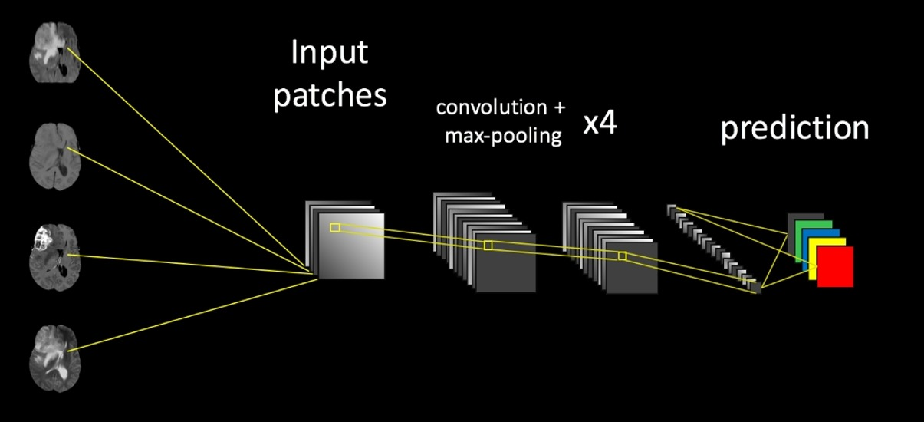
Model Architecture:
Department of Computer Science and Engineering - AIML

Slide 13
SYSTEM REQUIREMENTS AND SPEICIFICATION
1. Operating System: Windows, preferred for compatibility with deep learning tools.
2. Programming Language: Python, the primary language used for implementing deep learning models.
3. Deep Learning Frameworks: TensorFlow with Keras.
4. Data Processing Libraries: NumPy and Pandas
5. Visualization Tools: Matplotlib and Seaborn: For data visualization and tracking model performance.
6. Development Environment: Jupyter Notebook, great for interactive coding and visualizations.
Department of Computer Science and Engineering - AIML

Slide 14
HARDWARE REQUIREMENTS
GPU :NVIDIA GTX 1650 for high-performance training.
CPU : Intel Core i5 or AMD Ryzen 5 for handling computations.
RAM : Minimum of 8 GB upto 16 GB recommended for larger datasets.
Storage : 512 GB SSD for faster data access; consider additional storage for large datasets.
Department of Computer Science and Engineering - AIML

Slide 15
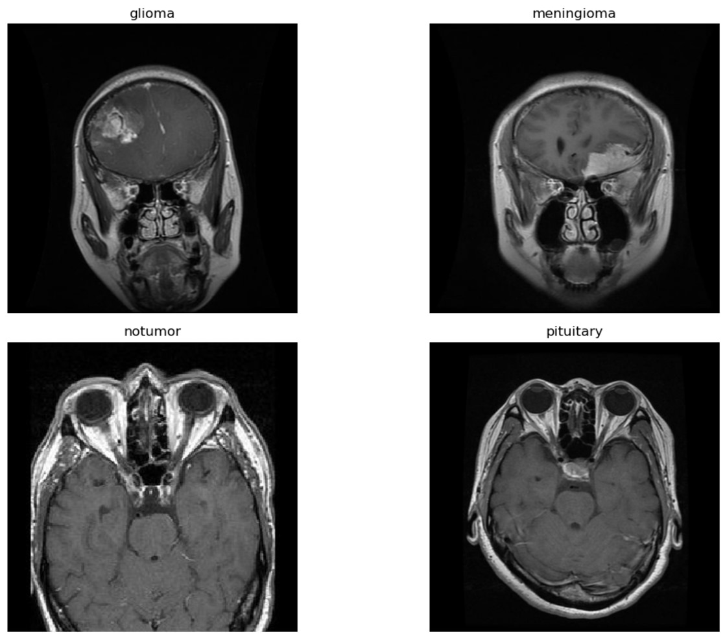
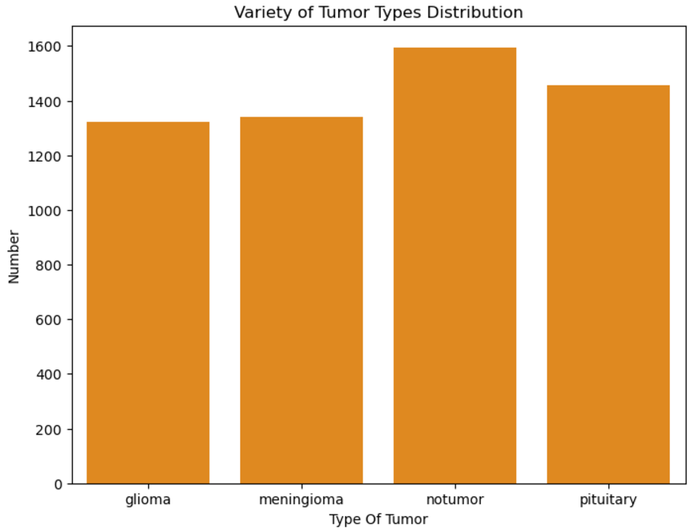
RESULTS
Department of Computer Science and Engineering - AIML

Slide 16
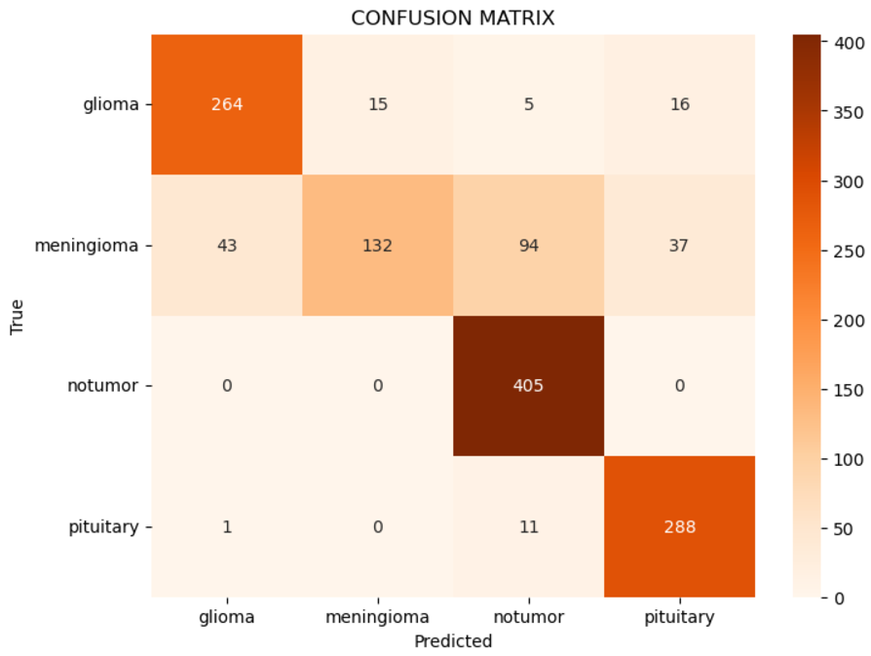
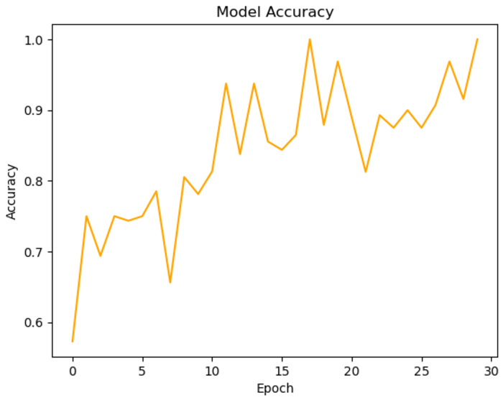
RESULTS
Department of Computer Science and Engineering - AIML

Slide 17
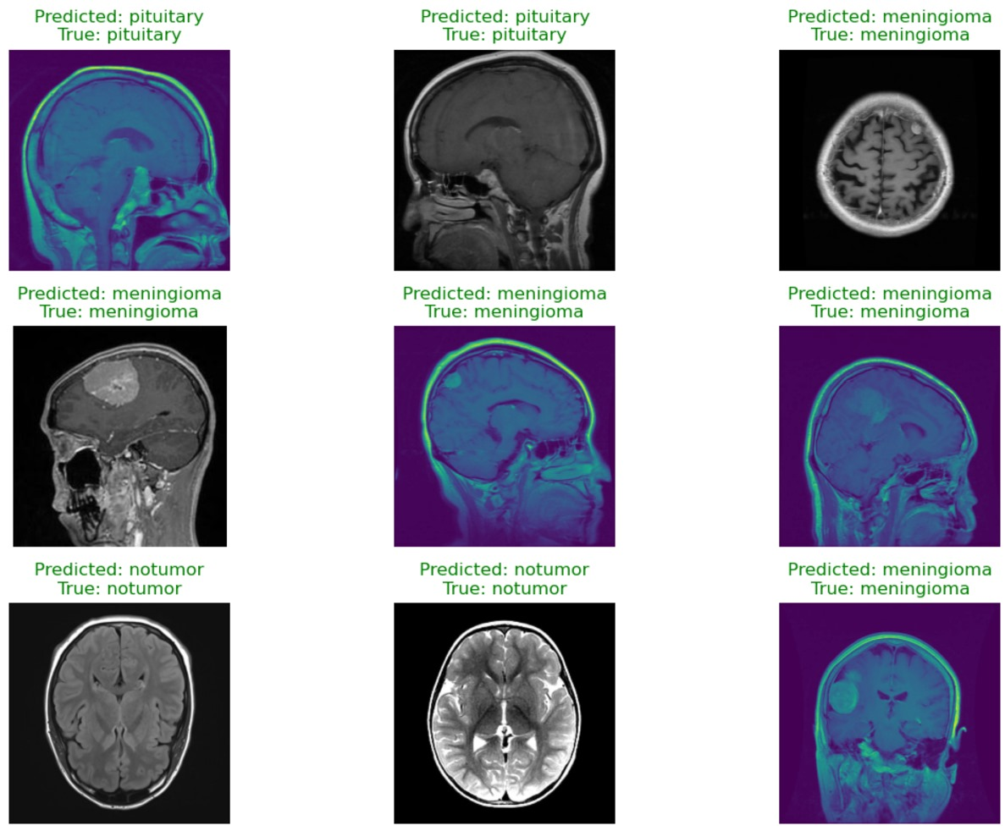
RESULTS
Department of Computer Science and Engineering - AIML

Slide 18
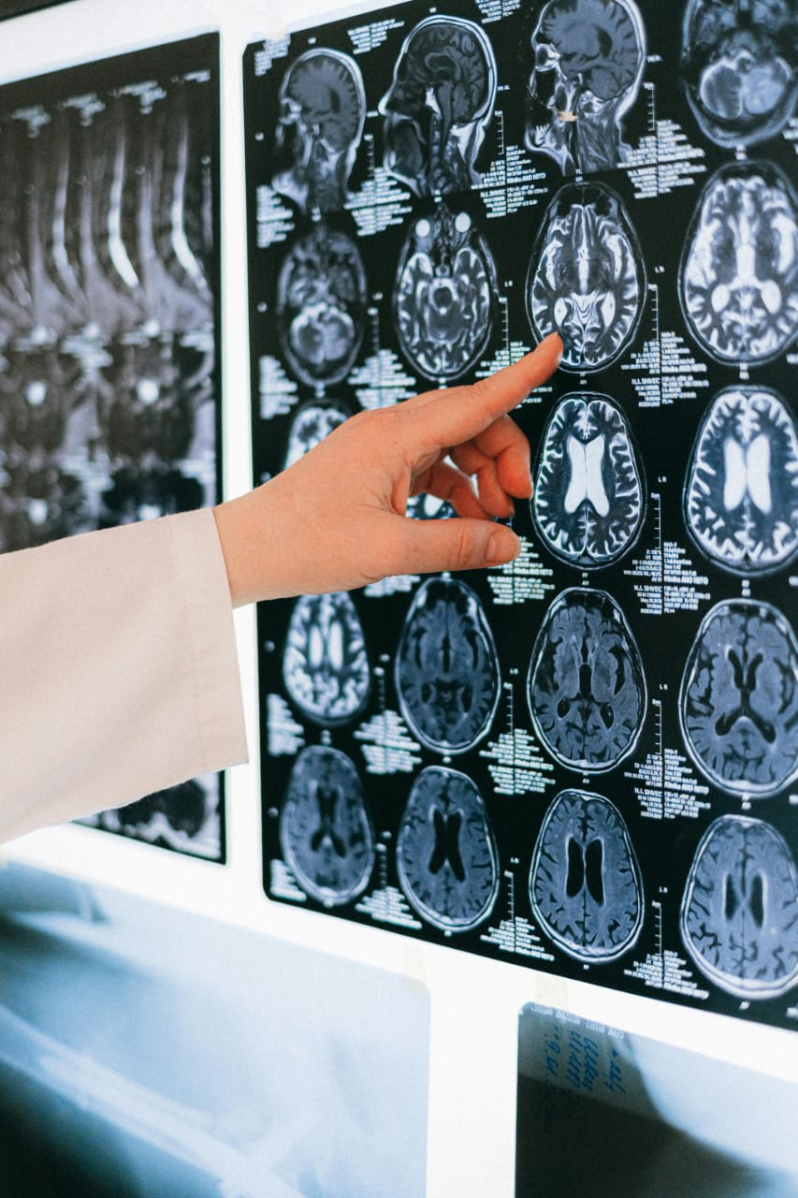
Conclusion:
In conclusion, the implementation of a highly precise Convolutional Neural Network (CNN) model for brain tumor classification demonstrates the immense potential of deep learning in medical imaging. With a classification accuracy of approximately 97%, the model proves to be a reliable and effective tool for assisting medical professionals in diagnosing brain tumors. The CNN's ability to extract and learn hierarchical features from MRI scans enables it to distinguish between different tumor types with exceptional precision. This high accuracy not only minimizes the risk of misdiagnosis but also enhances decision-making, ultimately contributing to improved patient outcomes.
Department of Computer Science and Engineering - AIML

Slide 19
Future Scope
Enhancing Dataset Diversity and Quality: Future work can focus on curating larger and more diverse datasets, including different MRI modalities, scanner types, and patient demographics, to improve the model's robustness, generalizability, and applicability across various clinical scenarios.
Real-Time Tumor Localization and Analysis: Developing models capable of real-time tumor segmentation and classification could assist in surgical planning and intraoperative decision-making, leading to more precise and effective treatments.
Deployment in Clinical Environments: Efforts can focus on translating the CNN model into user-friendly software or mobile applications, enabling its use by clinicians in resource-limited settings or for telemedicine applications.
Personalized Treatment Recommendations: Expanding the model to predict tumor aggressiveness, recurrence likelihood, or responsiveness to specific treatments could facilitate personalized treatment plans, improving patient outcomes.
Department of Computer Science and Engineering - AIML

Slide 20
REFERENCES :
[1] Sachin S. Patil, V. Kumar (2021).Brain Tumor Classification Using Convolutional Neural Networks. IEEE Access, Vol. 9, pp. 72788-72799. [Link](https://ieeexplore.ieee.org/document/9478483)
[2] Kamran, A., Khan, S., & Ahmad, S. (2022). Deep CNN with Connected CRF for Brain Tumor Segmentation. IEEE Access, Vol. 9, pp. 54242-54254. [Link](https://ieeexplore.ieee.org/document/9374549)
[3] Ozan Oktay, Jo Schlemper, Loic Le Folgoc. (2022). Attention U-Net: Learning Where to Look for the Pancreas. IEEE Access, Vol. 9, pp. 67018-67026. [Link](https://ieeexplore.ieee.org/document/9484379)
[4] P. Afshar, M. Plataniotis, A. Mohammadi. (2021). Brain Tumor Segmentation and Classification Using CNN, Vol. 40, No. 3, pp. 889-900. [Link](https://ieeexplore.ieee.org/document/9134568)
[5] H. Talo, Y. Baloglu, O. Yildirim. (2023). Multi-Scale Attention Convolutional Neural Network for Brain Tumor Classification. IEEE Transactions on Neural Networks and Learning Systems, Vol. 32, No. 6, pp. 1211-1220. [Link](https://ieeexplore.ieee.org/document/9197789)
Department of Computer Science and Engineering - AIML

Slide 21
Thank You
Department of Computer Science and Engineering - AIML

